Slide 1

Department of Information Technology
NBA Accredited
A.P. Shah Institute of Technology
G. B. Road, Kasarvadavli, Thane(W), Mumbai-400615
UNIVERSITY OF MUMBAI
Academic Year 2021-2022

Slide 2
A Project Report on
Implementing Comprehensive Blockchain based
Framework for Transparent Real Estate Transactions
Submitted in partial fulfilment of the degree of
Bachelor of Engineering(Sem-8)
in
INFORMATION TECHNOLOGY
By
Amit Pandey (18104042)
Rajan Khade (18104020)
Aditya Shinde (18104034)
Under the Guidance of
Prof. Neha Deshmukh

Slide 3
1.Project Conception and Initiation

Slide 4
1.1 Abstract
In India currently there are many problems faced by e-governance system in some areas of the public sphere. One such concern is addressing the issues within the traditional property registration system. The existing process is combination of manual process for registration and digital process for storing the records in centralized database. It is time consuming, comparatively less secure and tedious.
To make the entire process secure, digital and decentralized there is need of new design and architecture for the whole system. The proposed solution solves this by making the whole process digtal and decentralized using permissioned blockchain technology and a web appplication.

Slide 5
1.2 Objectives
To make process less time consuming.
To bring transparency with the use of blockchain.
To reduce the fraud cases.
To make the process of real estate transactions fully digital.

Slide 6
1.3 Literature Review
Authors | Title | Findings
N. Lazuashvili, A. Norta, and D. Draheim | Integration of blockchain technology into a land registration system for immutable traceability: A case study of Georgia | Data security, such as cyber-attacks and data breaches are major reason for adopting blockchain technology to achieve decentralization.
A. Gunda and S. Shukla | Property registration and land record management via blockchain | Even after the digitization of the records, they often seems to be out of sync or not up to date. Permissioned blockchain is more suitable for real estate transactions.
A. Nadeem and S. Jan | A Transparent and Trusted Property Registration System on Permissioned Blockchain | Presented techniques are based on Ethereum which unnecessarily consumes ethers for every transaction.

Slide 7
1.4 Problem Definition
The involvement of middlemen and brokers.
The increasing number of fraud cases.
Time delays.
Lack of digital protection.

Slide 8
1.6 Technology stack
Blockchain
Hyperledger Fabric
Docker
Chaincode - Go
Web Application
Backend – Node.js, Express.js
Frontend - HTML, CSS, JavaScript
Database (session storage) - MongoDB

Slide 9
1.7 Benefits for environment & Society
Reducing use of paper.
Preventing frauds.
Digital way for real estate transactions.

Slide 10
2. Project Design

Slide 11
2.1 Proposed System
Permissioned Blockchain - Hyperledger Fabric
Central Government
Orderer node
Certification Authority
State Government
Channel
Peer nodes, Ledger
Applications
Chaincode (Smart Contract)

Slide 12
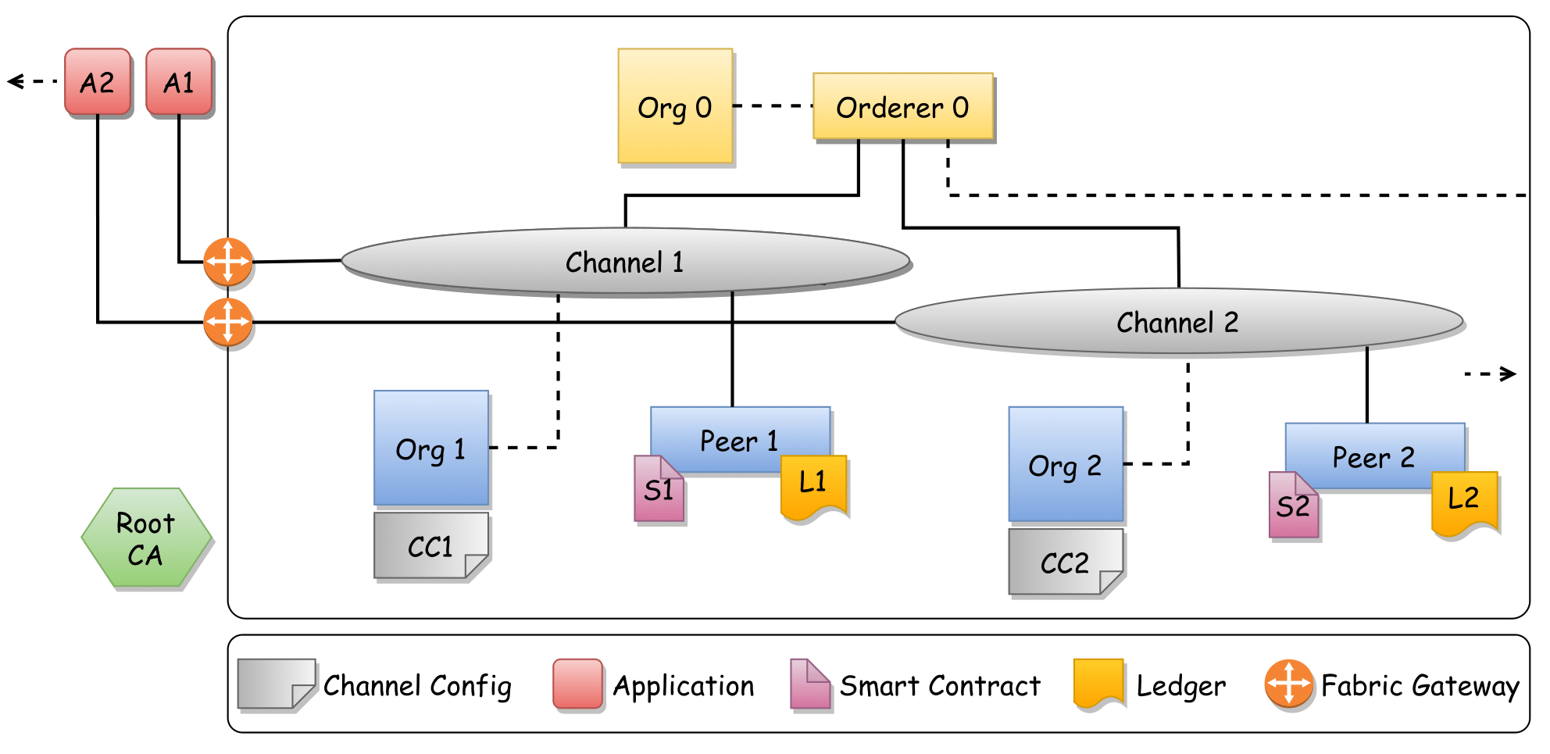
2.2 Architecture
Fig. 2.1 Proposed Fabric Network Architecture

Slide 13
2.3 Description Of Use Case
Central government
Configure and maintain orderer node.
Administer Certification Authority.
Create Channels for all the states.
State governments
Configure and maintain respective peer nodes.
Join respective Channel.
Develop and maintain Chaincode.
Develop web application.
Users – Registrar, General Public
Use web applications (A1, A2, etc.)

Slide 14
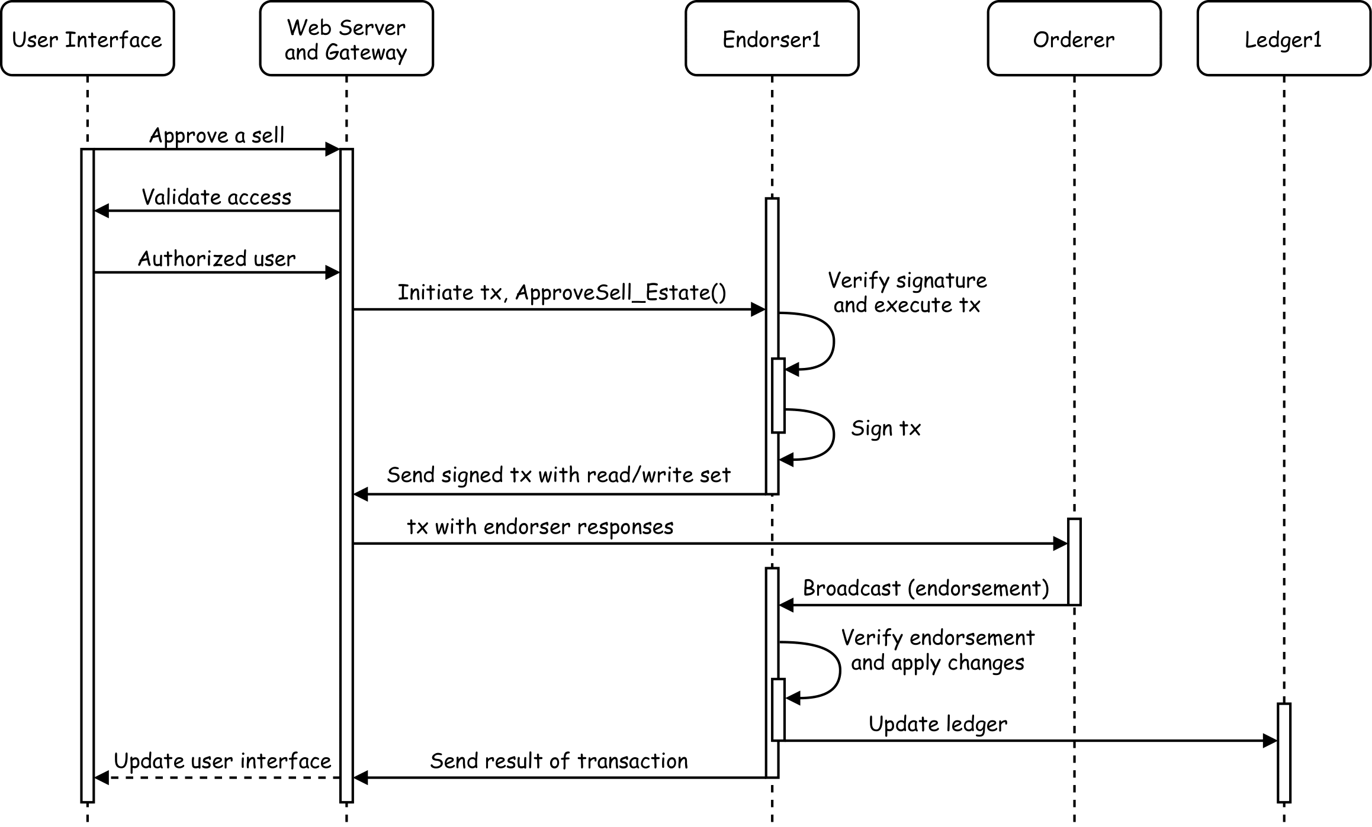
2.6 Sequence Diagram
Fig. 2.2 Sequence Diagram – Registrar approving sell of a estate

Slide 15
3. Implementation

Slide 16
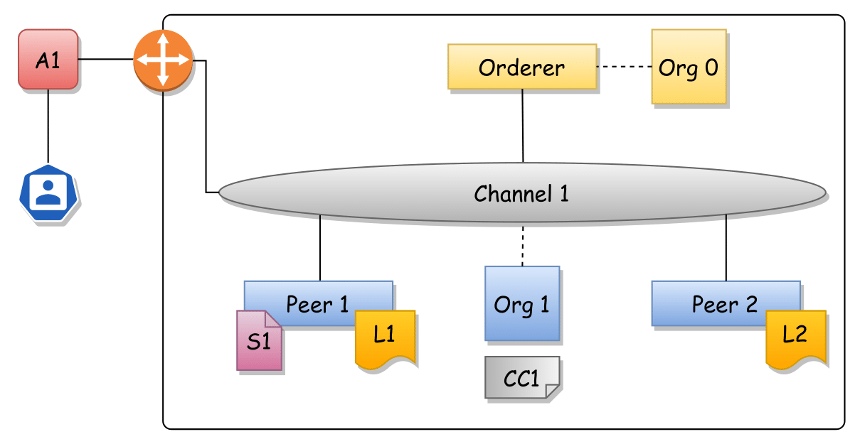
3.1 Architecture
Fig. 3.1 Implemented Fabric Network Architecture

Slide 17
3.2 Use Case
Implementation for a single state.
Chaincode development.
Web application for users.
Process to perform a real estate transaction:
Buyer - Verification of ownership
Buyer - Send request with proposed price to seller, using ULPIN (Unique
Land Parcel identification Number) of estate
Seller - Accept the request
Buyer - Pay stamp duty and registration charges
Registrar - Verify details and execute the transaction

Slide 18
4. Testing and Results

Slide 19
4.1 Throughput Testing
Executing a chaincode method/function using,
Query operations - Reading data from the Ledger a single peer without consensus.
Invoke operations – Reading or writing data to ledger with consensus.

Slide 20
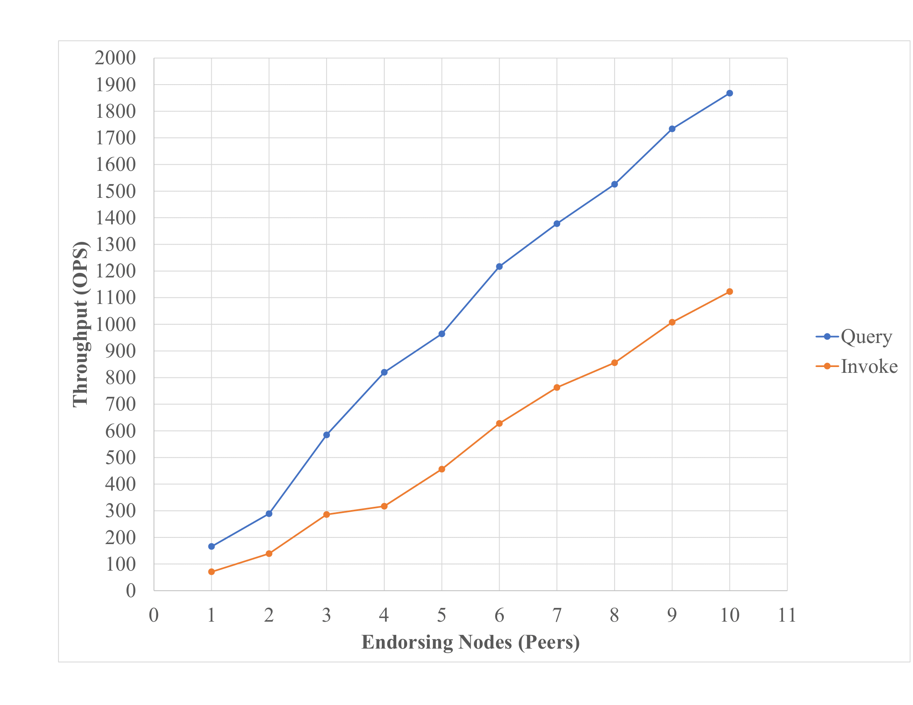
Fig. 4.1 Effect of the Peers Count on throughput of Query and Invoke operations

Slide 21
5. Conclusion and Future Scope

Slide 22
5.1 Conclusion
Modern solution to prevent and overcome the problems the current World Records Management System in India is facing.
Decentralization results in secure and temper proof system.
Use of TLS makes communication between all nodes secure.
Permissioned nature gives provides decentralization, strict administration and high throughput for transactions.
for any successful implementation of the technology, seam-less acceptance by stakeholders is required.

Slide 23
5.2 Future Work
Many additional features can be added to this framework, like more details of the property and its geography.
The chaincode can be improved and tested to make it more efficient.
There is a need to handle cases where the property has shared ownership.
To make the framework a complete solution a native cryptocurrency can be added to do all types of payments.

Slide 24
References
Lazuashvili, N., Norta, A., Draheim, D.: Integration of blockchain technology into a land registration system for immutable traceability: A casestudy of georgia. Springer International Publishing (2019)
Gunda, A., Shukla, S.: Property Registration and Land Record Management via Blockchain. Master’s thesis, Indian Institute Of Technology Kanpur (2019)
Brotsis, S., Kolokotronis, N.: On the security and privacy of hyperledger fabric: Challenges and open issues. In: 2020 IEEE World Congress on Services (SERVICES). pp. 197–204 (2020).
Foschini, L., Gavagna, A.: Hyperledger fabric blockchain: Chaincode performance analysis. In: ICC 2020 - 2020 IEEE International Conference on Communications (ICC). pp. 1–6 (2020)
Dilrmp.in: Digital india land record modernization programme, https://dolr.gov.in/programme-schemes/dilrmp/digital-india-land-recordmodernization-programme

Slide 25
Paper Publication
The Paper entitled “Blockchain based Web Framework for Real Estate Transactions”was presented at “5 th International Conference on Computer Networks and Inventive Communication Technologies” for the Scopus indexed Springer journal by “Rajan Khade, Amit Pandey, Aditya Shinde and Neha Deshmukh”.

Slide 26
Thank You

